Slide 1


Asyncing and Awaiting Windows 8
Michael L Perry
@MichaelLPerry
Michael@qedcode.com
qedcode.com

Slide 2

Synchronous

Slide 3
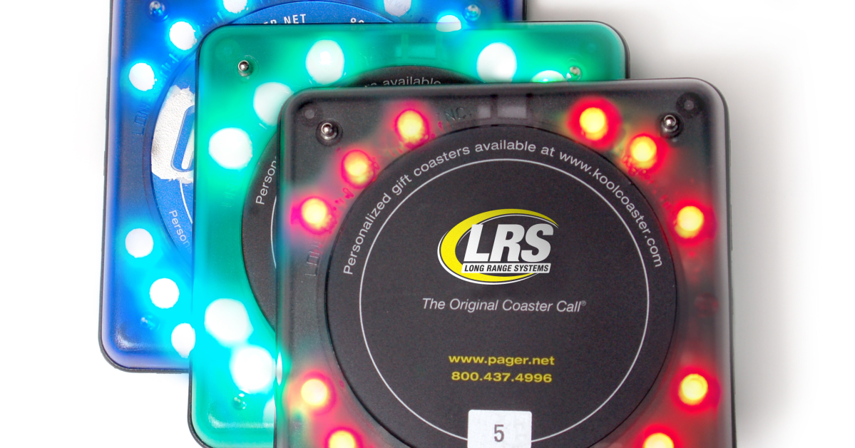
Asynchronous

Slide 4
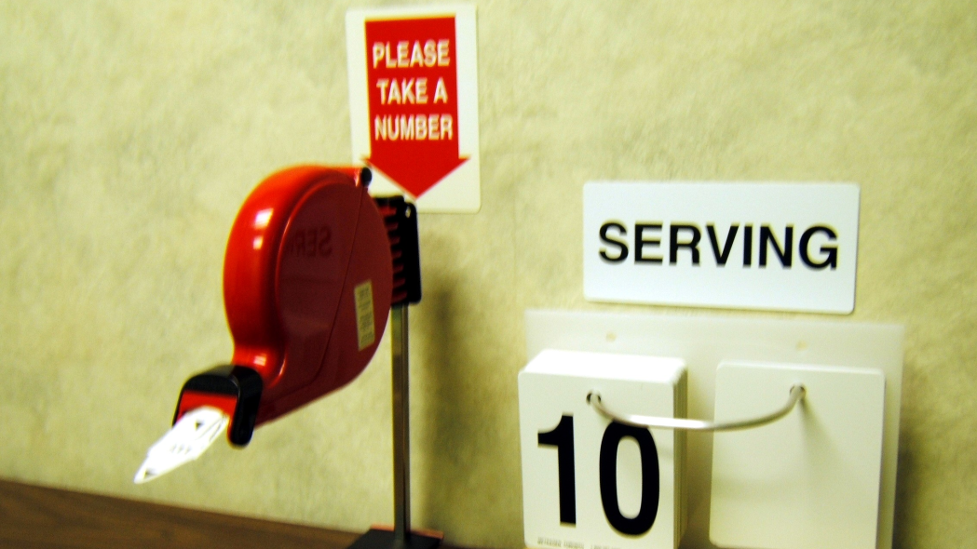
Asynchronous

Slide 5
State Machine
async Task<T> f ( )
{
Task<A> ta = …;
A a = await ta;
Task<B> tb = …;
B b = await tb;
T t = …;
return t;
}
Task<T> f ( )
{
Task<A> ta = …;
}
a
b
t
f_{a}
f_{b}

